Slide 1

Vacation to Europe made easier by Data Science
Group project (MIS 665) by:
Nicole hamler
Zach rottinghaus
Aref shafiei

Slide 2
Outline
Introduction
Data explanation
Data cleaning
Data visualization
Types of data analysis technique
Conclusion

Slide 3

Introduction
Importance of tourisms in Europe?
1.2 billion tourism trips in 2015 for personal or business purposes.
A huge amount of data collected by enterprises and agencies.
Data science can help gathering and analyzing data
Tourism industry and its competiveness is becoming popular day to day

Slide 4

Introduction
What are business questions?
How can a vacation to Europe be made more enjoyable?
Without first-hand experience, how can picking a hotel be made easier?

Slide 5

Introduction
What are business questions?
Which hotels in Europe have the highest customer ratings?
Which hotels in Europe provide the best service for the best price?
What are the characteristics of the best hotels in Europe?
Does location play a role?
What’s more important to customers, price or amenities?

Slide 6

Introduction
Expected Benefits:
Travel plans made simpler for individuals
Hotels can use information to improve and increase competitiveness
Websites such as Booking.com (data source) can use this to promote highest ranking hotels

Slide 7

Data explanation
Source of dataset:
https://www.kaggle.com/jiashenliu/515k-hotel-reviews-data-in-europe
Booking.com

Slide 8
Data explanation
Dataset includes :
Hotel_Name: different hotels cross Europe
Reviewer_Nationality: Nationality of costumers
costumer’s reviews on their stay (Negative_Review, Positive_Review)
Total number of reviews
Costumers’ scores given to hotels
Number of Days since the review has been given
Purpose of customers trip
Accompanies with costumer (ex. Group, family with young children, couple, solo traveler and etc..)
Type of room
Number of nights stayed at hotel
Latitude geography information of hotels

Slide 9
Data cleaning
Some unnecessary data and columns were removed such as ‘days snice review’ and ‘reviewers nationality’.
There is no missing data
10 columns in total
512470 rows in total including object, float64 and int64

Slide 10
Data analysis and visualization
Packages used in this presentation:
Pandas
Numpy
Seaborn
Sklearn.cluster
Sklearn
Matplotlib.pyplot
Mpl_toolkits.mplot3d
Scipy
Geopandas
Shapely.geometry
Textblob
bokeh

Slide 11
Data analysis and visualization
top ten hotels based on average scores:
Hotel_Name | Average_Score
Ritz Paris | 9.8
41 | 9.6
H tel de La Tamise Esprit de France | 9.6
H10 Casa Mimosa 4 Sup | 9.6
Haymarket Hotel | 9.6
Hotel The Serras | 9.6
Hotel Casa Camper | 9.6
Charlotte Street Hotel | 9.5
Milestone Hotel Kensington | 9.5
Waldorf Astoria Amsterdam | 9.5

Slide 12
Data analysis and visualization
Bottom ten hotels based on average scores :
Hotel_Name | Average_Score
Gainsborough Hotel | 6.9
Bloomsbury Palace Hotel | 6.8
Villa Eugenie | 6.8
Ibis Styles Milano Palmanova | 6.7
Commodore Hotel | 6.7
The Tophams Hotel | 6.6
Best Western Maitrise Hotel Edgware Road | 6.6
Savoy Hotel Amsterdam | 6.4
Hotel Cavendish | 6.4
Hotel Liberty | 5.2

Slide 13
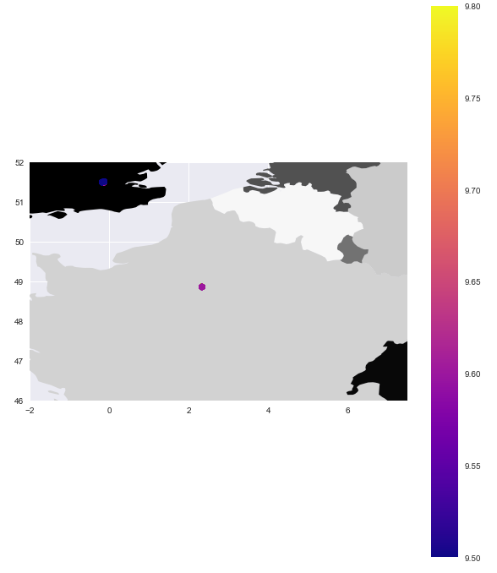
Data analysis and visualization
top ten hotels using Geospatial

Slide 14
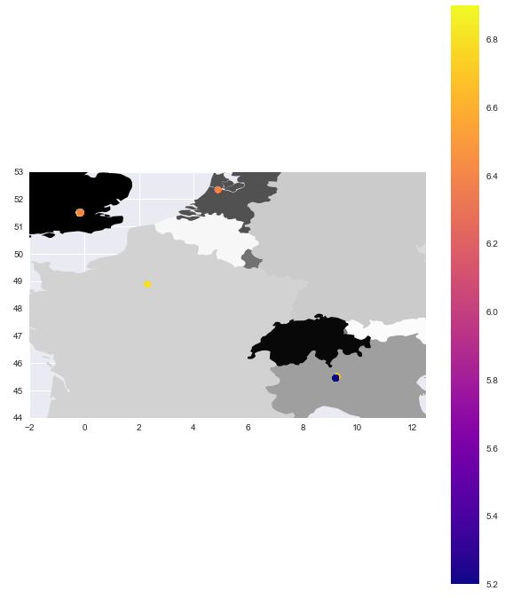
Data analysis and visualization
Bottom ten hotels using Geospatial

Slide 15
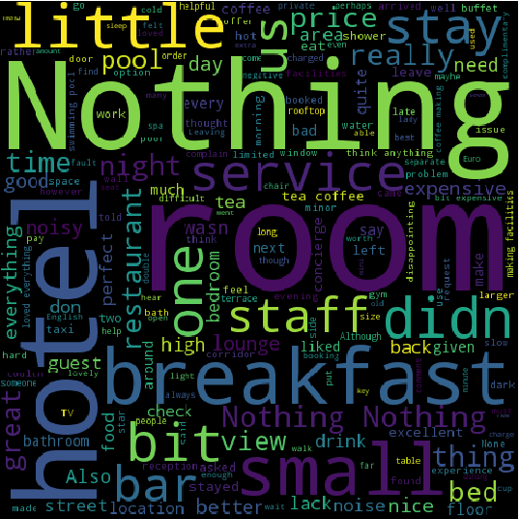
Data analysis and visualization
Analyzing negative reviews of top 10 hotels by WordCloud

Slide 16
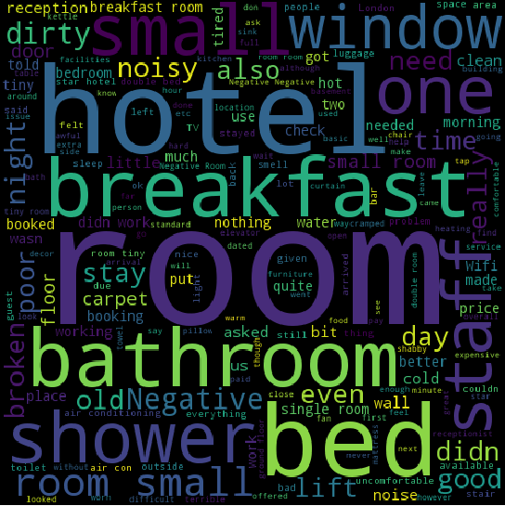
Data analysis and visualization
Analyzing negative reviews of bottom 10 hotels by WordCloud

Slide 17
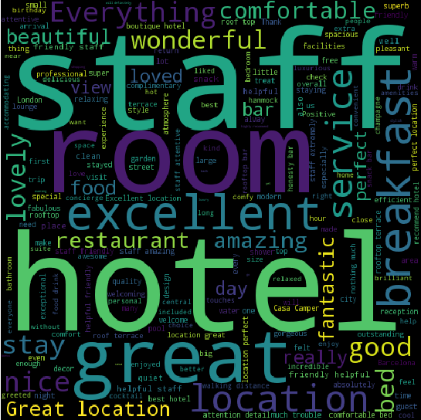
Data analysis and visualization
Analyzing positive reviews of top 10 hotels by WordCloud

Slide 18
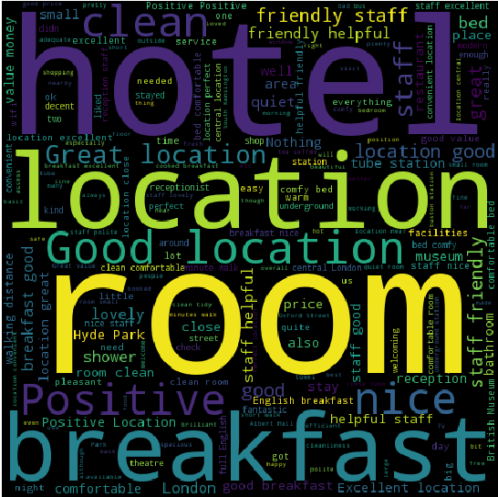
Data analysis and visualization
Analyzing positive reviews of bottom 10 hotels by WordCloud

Slide 19
Exploratory Data Analysis - statistical hypothesis testing

Slide 20
Correlation analysis:
There is strong negative correlation between latitude and number of total reviews for top 10 hotels
 | Average_Score | Review_Total_Negative_Word_Counts | Total_Number_of_Reviews | Review_Total_Positive_Word_Counts | lat | lng
Average_Score | 1 | -0.041882 | 0.159074 | 0.068548 | -0.495459 | -0.003392
Review_Total_Negative_Word_Counts | -0.041882 | 1 | -0.06091 | 0.145168 | 0.075332 | 0.023287
Total_Number_of_Reviews | 0.159074 | -0.06091 | 1 | 0.120088 | -0.822986 | 0.466096
Review_Total_Positive_Word_Counts | 0.068548 | 0.145168 | 0.120088 | 1 | -0.132734 | 0.023169
lat | -0.495459 | 0.075332 | -0.822986 | -0.132734 | 1 | -0.282306
lng | -0.003392 | 0.023287 | 0.466096 | 0.023169 | -0.282306 | 1

Slide 21
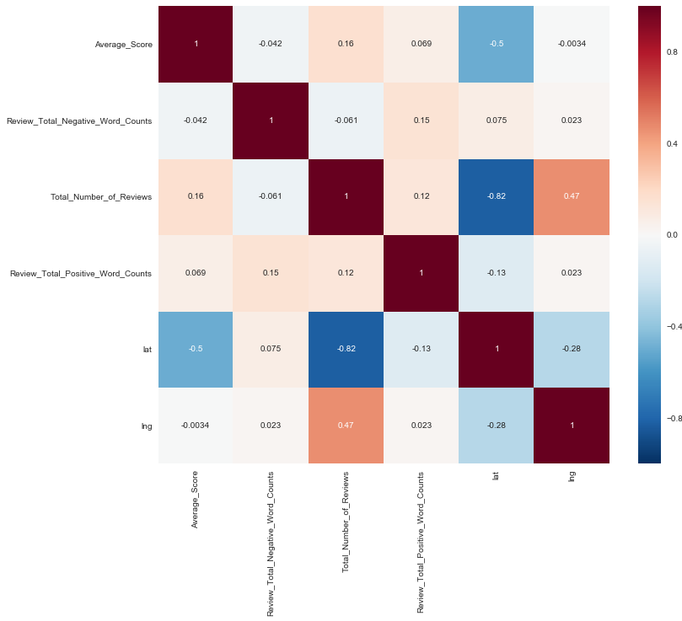
Correlation analysis
Correlation analysis using heatmap for top 10 hotels

Slide 22
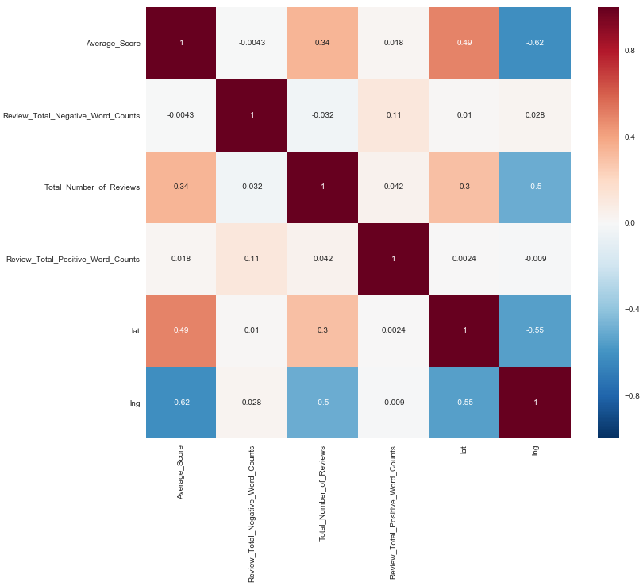
Correlation analysis
Correlation analysis using heatmap for bottom 10 hotels

Slide 23
Correlation analysis
Correlation analysis between hotel name and the negative word count in the reviews is negative, indicating that high profile hotels on the list are less likely to receive negative reviews. However, the correlation between positive and negative word counts are relatively high and positive showing that reviewers who have longer positive reviews also tend to have longer negative reviews and vice versa. The average score is positively related to the hotel name but not by so much that it does not show higher ratings based on hotel name alone.

Slide 24
Hypothesis Testing¶

Slide 25
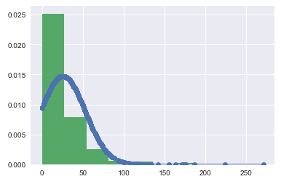
Hypothesis Testing
Normality test:
Normalizing Number of positive words for top 10 hotels

Slide 26
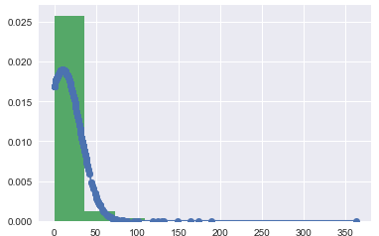
Hypothesis Testing
Normality test:
Normalizing Number of negative words for top 10 hotels

Slide 27
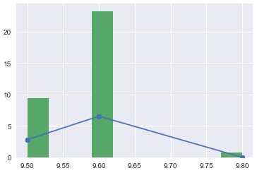
Hypothesis Testing
Normality test:
Normalizing average score for top 10 hotels

Slide 28
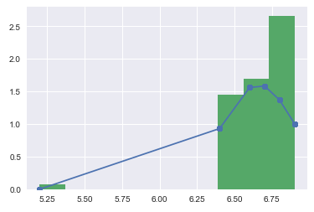
Hypothesis Testing
Normality test:
Normalizing average score for bottom 10 hotels

Slide 29
Text Analysis using TextBlob and NLTK (Natural Language ToolKit)

Slide 30
Text Analysis using TextBlob and NLTK (Natural Language ToolKit)
Sentiment Analysis:
Training the positive words by created vocabulary which reflects positive feeling such as ‘awesome', 'outstanding', 'fantastic', 'terrific', 'good', 'nice', 'great’
The classifier shows that the positive review has mostly a positive sentiment at 16% vs. 8% negative.
The classifier shows the positive reviews to be more positive than negative for the bottom 10 hotels. Therefore, the reviewer remains true to providing a positive review in spite of rating the hotel lower. The sentiment for this review is 12% positive and ~6% negative.
While not much higher, the negative reviews of the top 10 hotels are classified to be more positive than negative. The sentiment of the review shows to be ~4% positive and ~2% negative.
The classifier shows the negative reviews of the lowest rated 10 hotels to be more positive than negative!! This may be the most surprising in that the negative reviews are classified to be ~25% positive and ~14% negative.

Slide 31
Conclusion

Slide 32
Conclusion
Analyzing the top rated hotels and key words to look for when making plans is the key. Breakfast, location, and service are very important to consumers.
Reviews tend to be true to their purpose with the overall sentiment leaning towards positive even for lower rated hotels.
The Ritz in Paris is the overall highest rated hotel.
Location, great service, breakfast, staff, and the room are the biggest factors in a positive review.

Slide 33
Conclusion
To avoid a bad experience looking for how the breakfast, the service, and the size and condition of the room are rated.
The highest rated hotels are in London and in Paris. However, some of the lowest rated hotels are in London and Paris as well with Amsterdam being the only one to imply that location would play a role. Within Paris, location does play a role, with the highest rated hotels being located in the 1st Arrendement, and the lowest in the 17th Arrendement. In London, there is no clear distinction in the location of the hotels.

